Slide 1
house listings in Austin, Texas.
Group 1: Joseph Arias, Anthony Guillen, Jose Barreto, Mike Almeida, Moin Azad, Timothy Yu

Slide 2
Abstract
In this project, we utilized GitBash to execute Hadoop commands and employed Beeline to establish an external table for the Austin, TX House Listing dataset, accessible through the provided Kaggle link. The analysis involved querying diverse aspects such as house prices by year, number of rooms, and square footage within the Hadoop environment. Furthermore, we leveraged the extracted insights to generate informative bar graphs and 3D maps & charts using Tableau, offering a comprehensive visualization of the dataset's key metrics and trends.

Slide 3
INTRO TO AUSTIN HOUSING DATABASE
The dataset that we will be using is based on real estate out of Austin, Texas. This database has multiple data entries that consist of specific details of each house. From how big the lot size to, how many bathrooms and bedrooms it has. One of the main reasons why we chose this database is because we wanted to be able to isolate the most important details in this dataset to help new buyers. As we wanted to make sure that this was a tool for those new buyers in their search for a house.

Slide 4
DATA SIZE, Source, and INFORMATION
Data Source URL: https://www.kaggle.com/datasets/ericpierce/austinhousingprices/ 3GB
Analyzing the dataset to help buyers isolate on choices they want to
options on pricing
Lot size, number of bedrooms, number of bathrooms
Location of house
Buyers gain a better understanding of the market in Austin, Texas

Slide 5
Project Uniqueness
Our project stands out for its distinctive approach of exploring the Austin, TX House Market and leveraging Hadoop and Hive to execute queries through Beeline. By creating an external table within this environment, we conducted in-depth market analyses, exploring facets like cost variations, accessibility, and fundamental housing characteristics. What sets our project apart is not only our use of Hadoop but and our incorporation of Tableau for dynamic visualizations. Utilizing Tableau, we crafted compelling bar graphs, 3D maps, and charts, offering a comprehensive visual representation of the dataset and enhancing the interpretability of our housing market insights.

Slide 6
Relevance to topics In class
Our topic relates to a lab we did in class, specifically Lab #7 where we analyzed social media and customer sentiment with Hadoop and Tableau.. In lab #7 we learned how Tableau can import data of HDFS in our Hadoop Cloud and how to visualize the data from HDFS in Tableau about Go game of Google's Aphago vs. Se-Dol Lee. Similarly, in our project we analyzed the Austin, Tx House Listing data in beeline in Hadoop and imported HDFS data into our local computer for visualization in Tableau. We create beeline tables for Tableau visualization using the data set we downloaded for our big data.

Slide 7
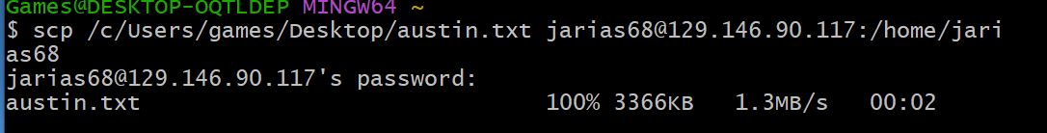
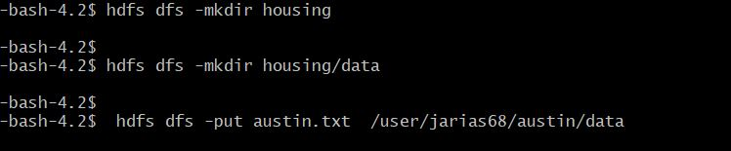
LOCAL TERMINAL AND HADOOP COMMANDS
Downloading the data set into the local terminal
Creating directory housing and sub directory data

Slide 8
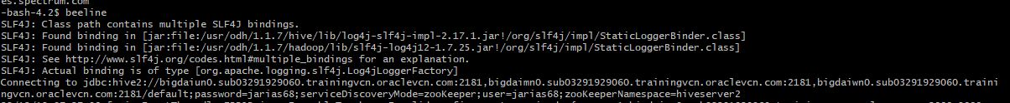
Accessing Apache hive
Accessing the Hive distributed file server via the beeline command
Specifying the database used for the session

Slide 9
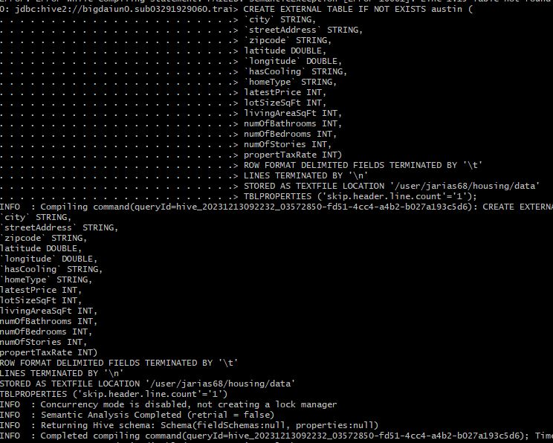
Hive Table Creation and schema definitions
Column Data Types
STRING: 'city', 'streetAddress', 'hasCooling', 'homeType'
INT: latestPrice, lotSizeSqFt, lotSizeSqFt, livingAreaSqFt, numOfBathrooms, numOfBedrooms, numOfStories, propertyTaxRate
DOUBLE: latitude, longitude

Slide 10
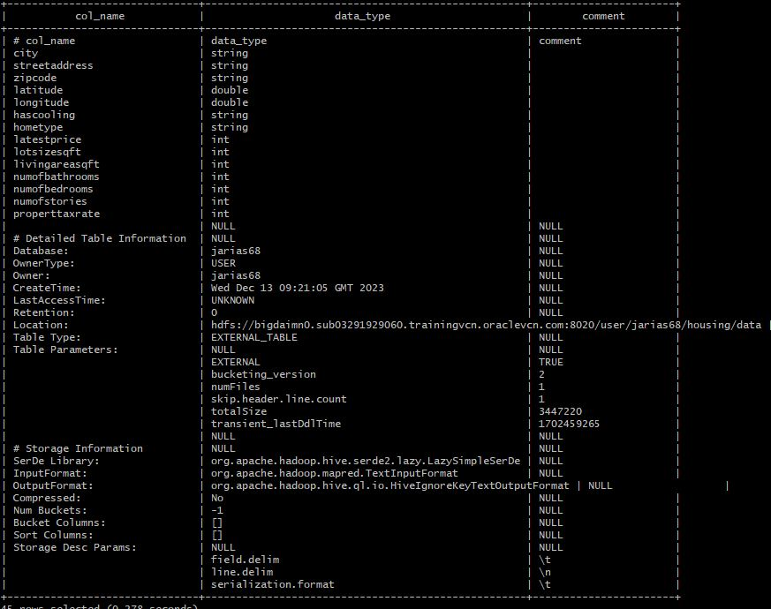
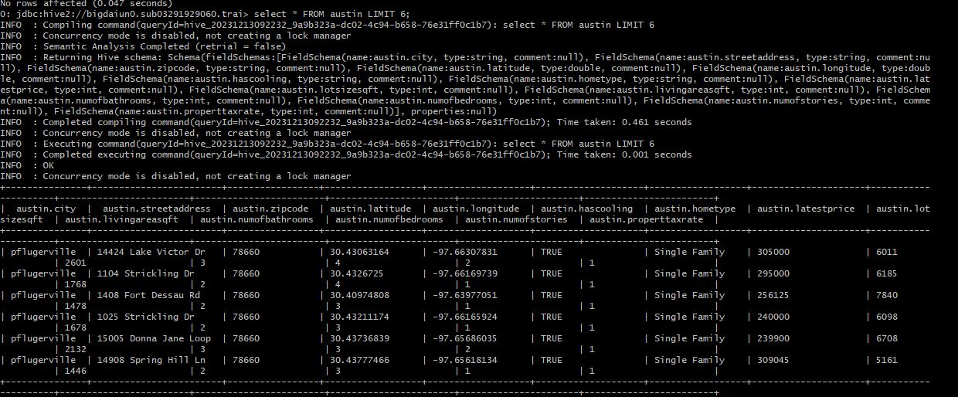
Describing Table and querying
Describe Formatted Command to reveal table metadata including:
Table Properties
File Format
Storage properties
Querying the created table reveals table information

Slide 11
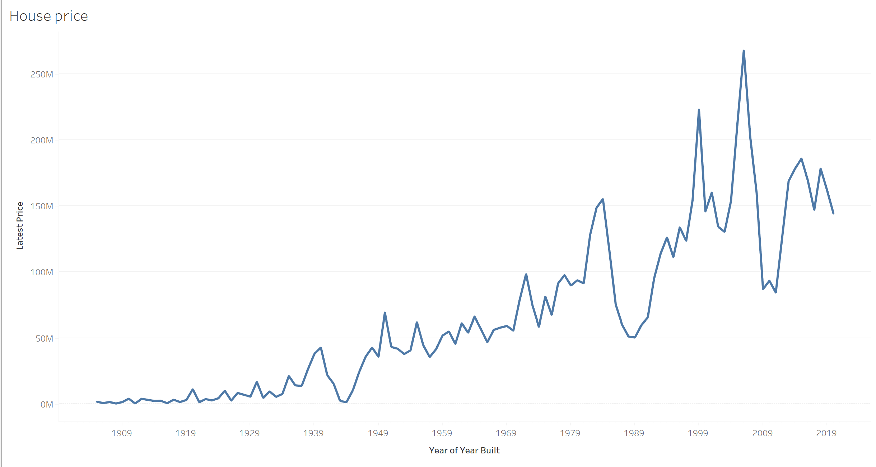
House price by year of built
Houses constructed after 1989 show a steady increase in value, reaching a peak in the early 2000s at $250 million. Properties built in the early 1980s also hold considerable value, while those constructed before that period continue to experience a decline in their market worth.

Slide 12
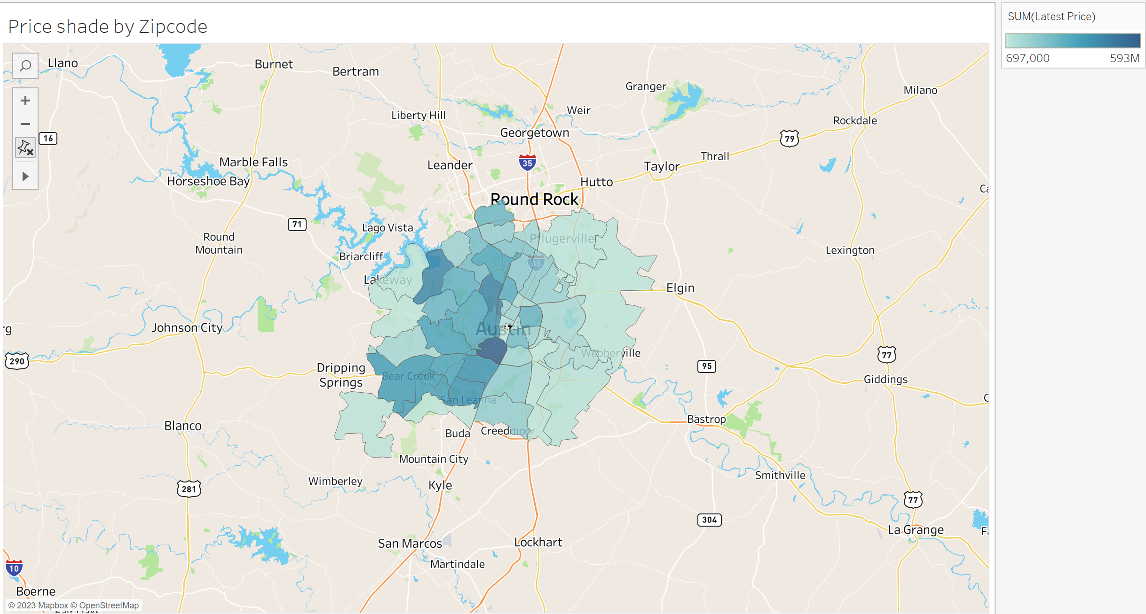
Price Shade by Zip code
Higher-valued houses tend to cluster closer to the center of Austin. As you move outward and westward, prices gradually decrease, while moving eastward results in a more rapid decline in property values.

Slide 13
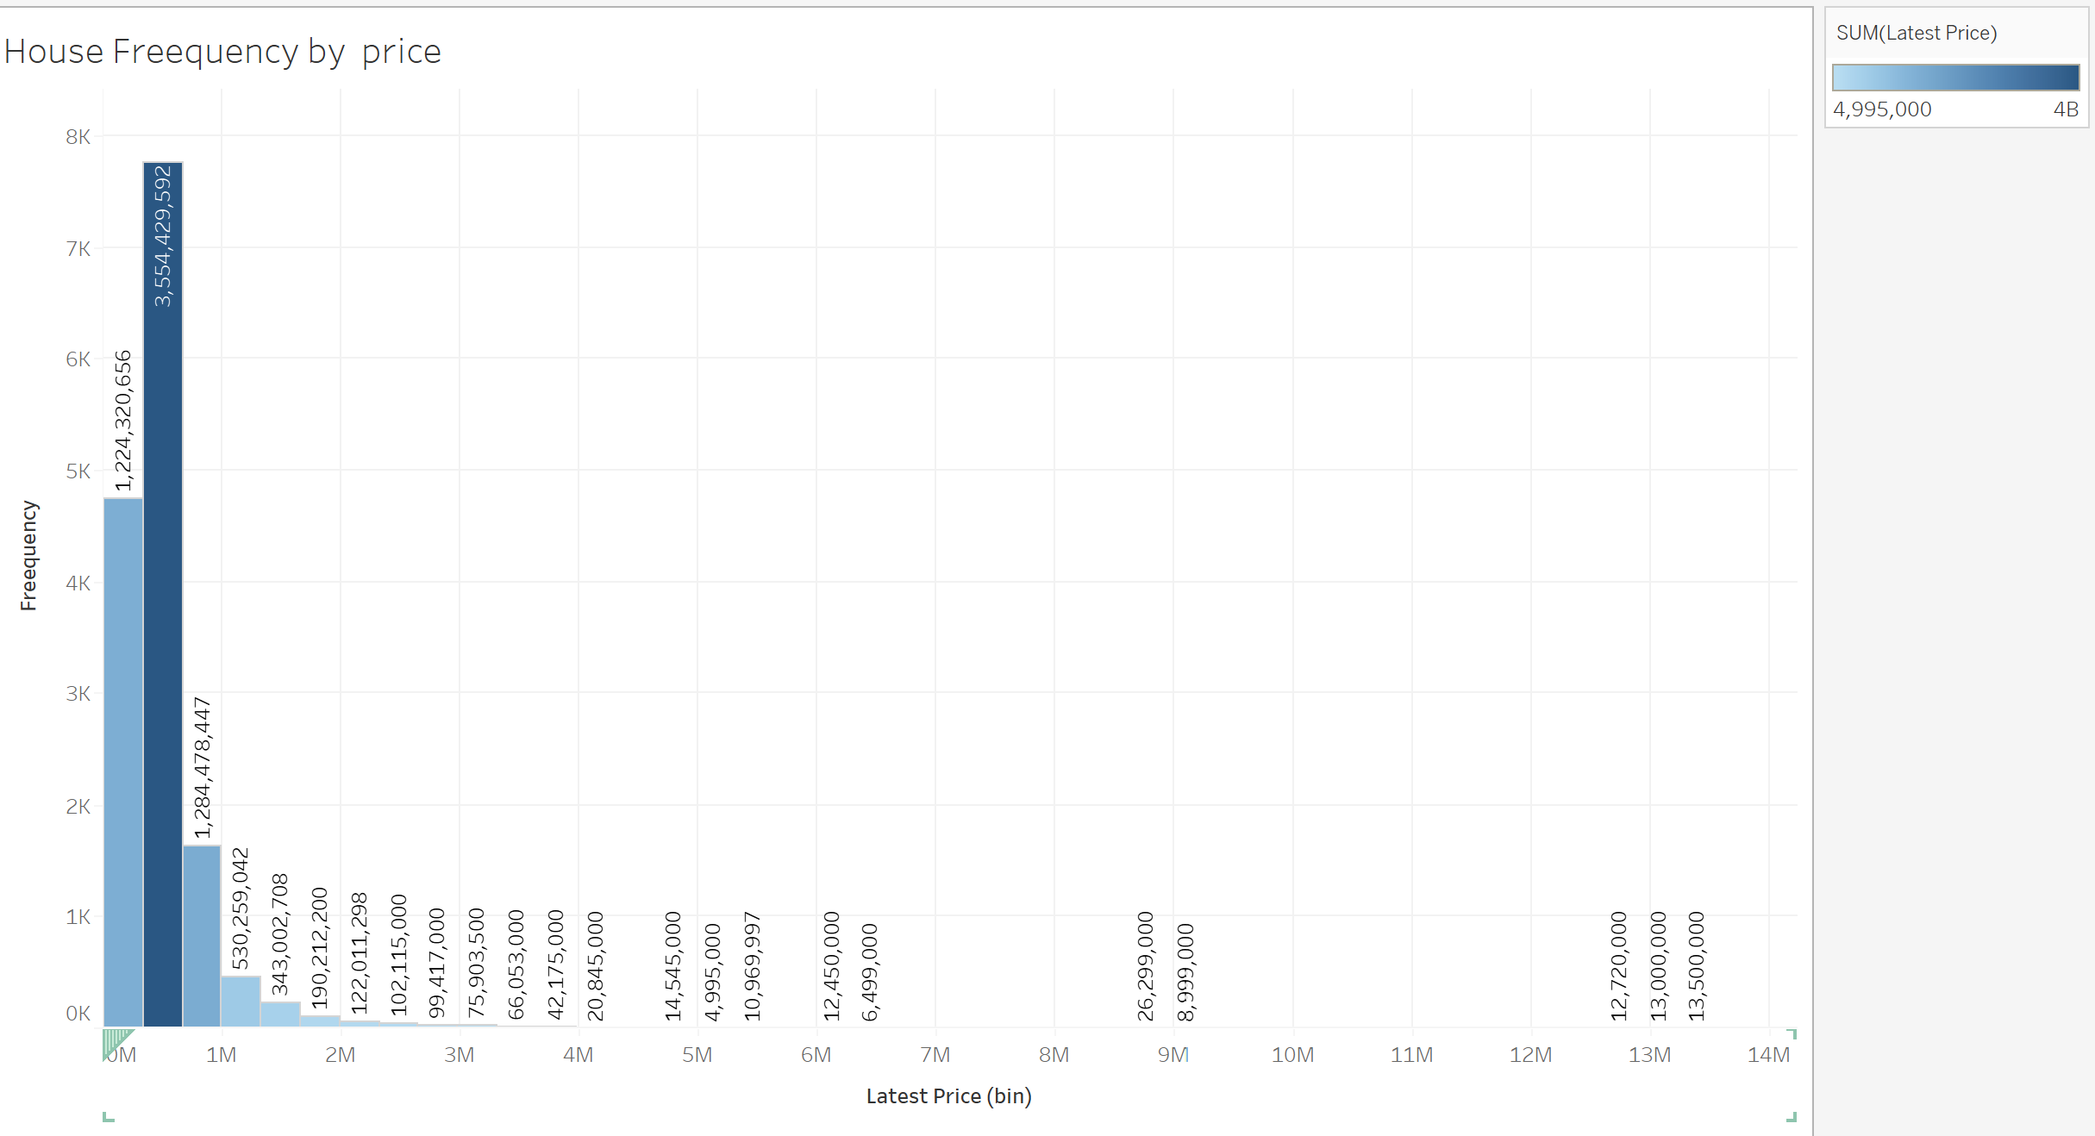
House Frequency by Price
Frequency distribution of latest prices reveals a significant peak at approximately $500,000, followed by a secondary peak at approximately $250,000, and a smaller peak at $750,000.

Slide 14
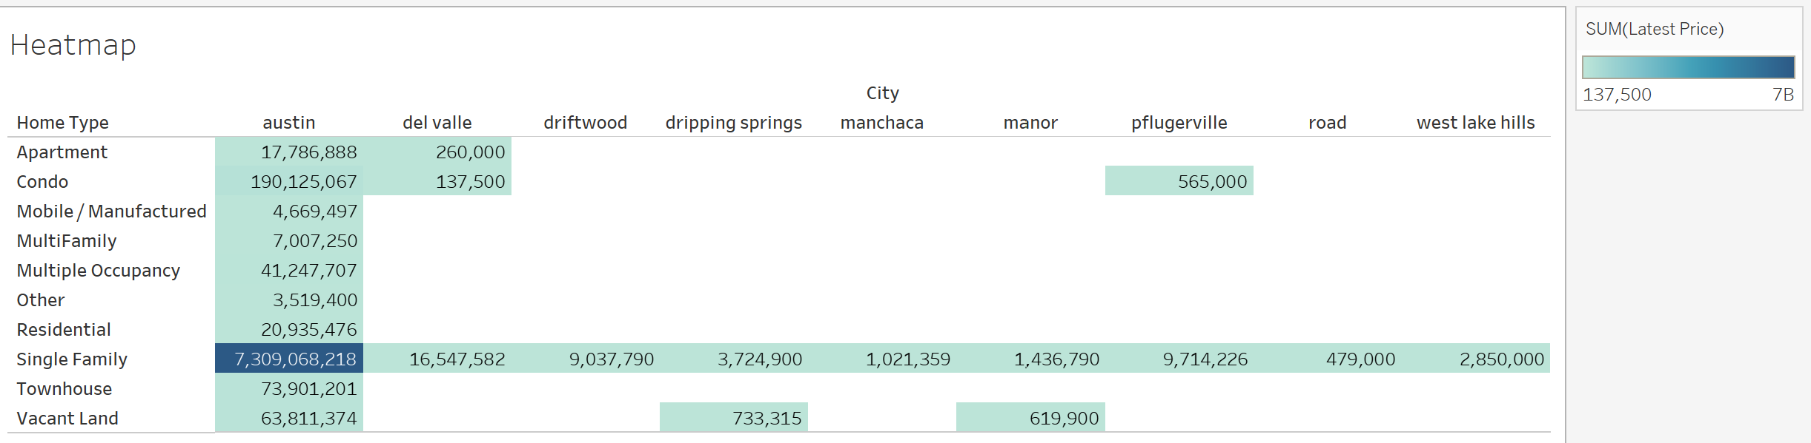
Heatmap by City
The heatmap illustrates the distribution of home types across different cities, with Austin standing out as the city with the highest concentration of single-family homes, reaching a peak value of $7,309,068,218.

